Slide 1
What are the New York State Tests?
January 19th, 2016
P.S. 174 Q
Presented by: Rich Bebenroth and Marie Russell

Slide 2
State Test Information: Students
Students in third through fifth grade will take the NYS ELA and Mathematics exam.
Certain English Language Learners are exempt from the NYS ELA. If you have questions about exemption please contact your child’s classroom or ELL teacher.
Fourth grade students will take a state science exam. An additional workshop will be held to provide information.

Slide 3
State Test Information: Dates
ELA
Tuesday, Tuesday, April 5th – Thursday, April 7th
Math
Wednesday, Wednesday, April 13th – Friday, April 15th
Spring Recess April 23rd-May 1st

Slide 4
State Test Information: Timing English language Arts
This table reflects 2015 data, 2016 is not released yet.
Proposed shorter times and less questions and passages for 2016
 | English Language Arts
Grade | Book | Estimated Time of Completion | Maximum Time of Completion | Day Administered
3 | 1 | 50 Minutes | 70 Minutes | 1
 | 2 | 50 Minutes | 70 Minutes | 2
 | 3
 | 4 | 50 Minutes | 70 Minutes | 3
 | Total Estimated Time: |  | 150 Minutes
4 | 1 | 50 Minutes | 70 Minutes | 1
 | 2 | 50 Minutes | 70 Minutes | 2
 | 3
 | 4 | 50 Minutes |  | 3
 | Total Estimated Time: |  | 150 Minutes
5 | 1 | 70 Minutes | 90 Minutes | 1
 | 2 | 60 Minutes | 90 Minutes | 2
 | 3
 | 4 | 50 Minutes | 90 Minutes | 3
 | Total Estimated Time: |  | 180 Minutes

Slide 5
Types of Questions ELA
Multiple Choice
Students read a passage and answer multiple choice questions about the passage. Questions could be factual, inferential, checking for meaning, or interpretative
Short Answer
Students will write a short one or two sentences to answer a question relating to a story.
Extended Response
Students will write a longer essay often comparing two passages. These sometimes compare characters, situations, or settings.
Samples from:
http://www.engageny.org/resource/released-2015-3-8-ela-and-mathematics-state-test-questions

Slide 6
Key Common Core ELA Changes when Switched to Common Core Testing
Fifty percent nonfiction text and fifty percent literary text
Longer passages of higher complexity and rigor
100% authentic texts

Slide 7
State Test Information: Timing Mathematics
This table reflects 2015 data, 2016 is not released yet.
Proposed shorter times and less questions and passages for 2016
 | Mathematics
Grade | Book | Estimated Time of Completion | Maximum Time of Completion | Day Administered
3 | 1 | 40 Minutes | 60 Minutes | 1
 | 2 | 40 Minutes | 60 Minutes | 2
 | 3 | 50 Minutes | 70 Minutes | 3
 | Total Estimated Time: |  | 130 Minutes
4 | 1 | 40 Minutes | 60 Minutes | 1
 | 2 | 40 Minutes | 60 Minutes | 2
 | 3 | 70 Minutes | 90 Minutes | 3
 | Total Estimated Time: |  | 150 Minutes
5 | 1 | 40 Minutes | 80 Minutes | 1
 | 2 | 40 Minutes | 80 Minutes | 2
 | 3 | 70 Minutes | 90 Minutes | 3
 | Total Estimated Time: |  | 150 Minutes

Slide 8
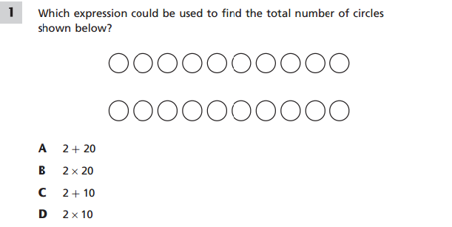
Types of Questions Math
Multiple choice
Sample from 3rd grade NYS released questions

Slide 9
Types of Questions Math
Short Answer
A cargo ship is carrying nine shipping crates. Each crate is equal in mass, and the total mass of all nine crates is 4,707 kilograms. What is the mass, in kilograms, of each crate?
Show your work.
Sample from 4th grade NYS released questions

Slide 10
Types of Questions Math
Extended Response
There are 12 players on a new softball team. Before the team starts playing games, the team must pay a total registration fee of $572. Along with the registration fee, the team will also need to spend a total of $1,240 on equipment. To pay for the cost of the registration fee and the equipment, the players held a car wash and raised $786. They then decided to sell candles for $9.50 per candle to cover the remaining costs. If each player sells the same number of candles, how many candles must each player sell?
Show your work.
Sample from 5th grade NYS released questions

Slide 11
Test Taking Tips
Do not put on undue pressure on your child.
Make sure they get a good night’s sleep.
Make sure they eat breakfast the day of the test.
Do not send your child to take the test if they are not feeling well (there are makeup days).
Send your child with sharpened #2 pencils with erasers, but no “lucky pencils” or “special erasers” as they can be a distractor.
Let them know that once the test is over, it is a normal day and the test is just a small part of that day.

Slide 12
Links
http://engageny.org/resource/test-guides-for-english-language-arts-and-mathematics
http://schools.nyc.gov/Academics/CommonCoreLibrary/default.htm
http://www.engageny.org/resource/released-2015-3-8-ela-and-mathematics-state-test-questions

